Slide 1


Python Programming for Chemical Engineers Root Finding
Muhammad Mufti Azis, Ph.D
Department of Chemical Engineering,
Faculty of Engineering, UGM, Indonesia

Slide 2



Background
We would like to solve:
Root finding from a single non linear equation, such as:
b. Root finding from a set of non-linear equations, such as:
$$e^{x}−x=0$$
$$e^{{−e}^{−(x_{1}+x_{2})}}−x_{2}(1+x_{1}^{2})=0$$
$$x_{1}\cos\left(x_{2}\right)+x_{2}\sin\left(x_{1}\right)−\frac{1}{2}=0$$

Slide 3

Learning Outcome
After this course, student should be able to:
develop computer program for root finding problems in Chemical Engineering
design a program structure that combines for loop and root finding algorithm

Slide 4
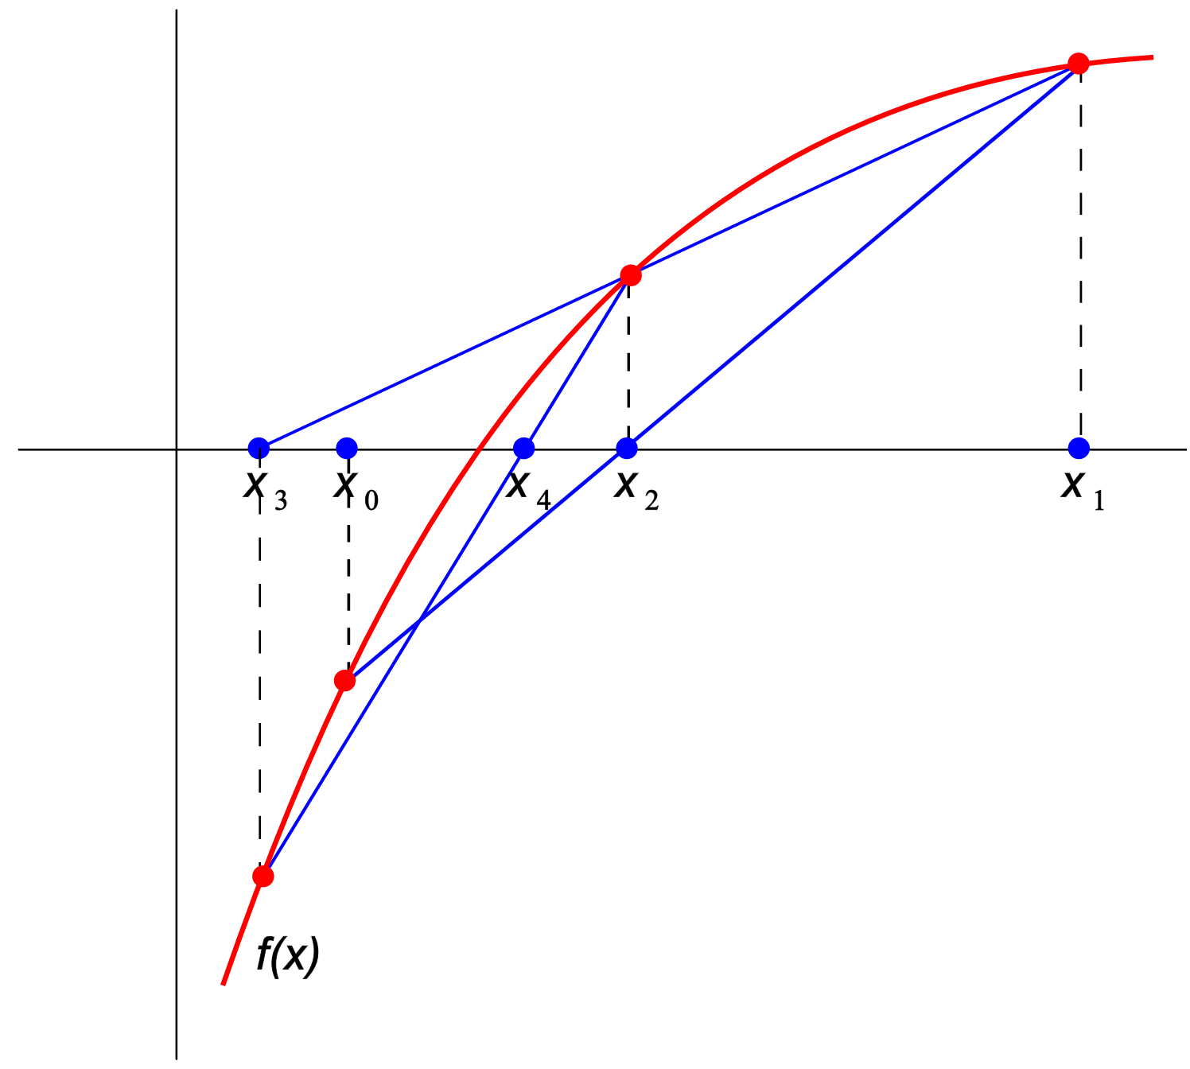
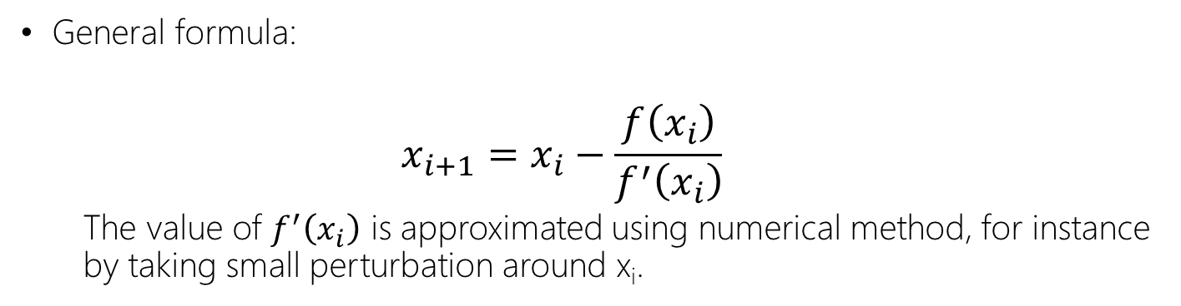
Newton Raphson/Secant Method
General formula:
$$x_{i+1}=x_{i}−\frac{f\left(x_{i}\right)}{f^{′}\left(x_{i}\right)}$$
The value of $f^{′}\left(x_{i}\right)$ is approximated using numerical method, for instance by taking small perturbation around x_{i}.
The secant method can be interpreted as a method in which the derivative is replaced by an approximation and is thus a quasi-Newton method. (Source: Wikipedia)

Slide 5
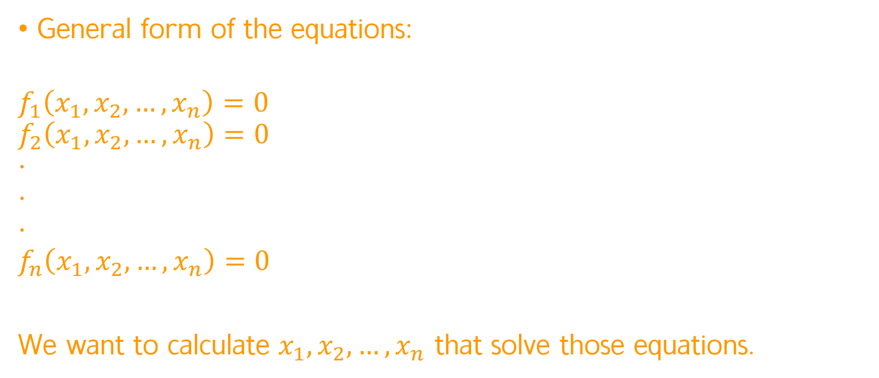
System of non-linear equations
General form of the equations:
$$f_{1}\left(x_{1},x_{2},…,x_{n}\right)=0$$
$$f_{2}\left(x_{1},x_{2},…,x_{n}\right)=0$$
$$⋅$$
$$⋅$$
$$⋅$$
$$f_{n}\left(x_{1},x_{2},…, x_{n}\right)=0$$
We want to calculate $x_{1},x_{2},…, x_{n}$ that solve those equations.

Slide 6
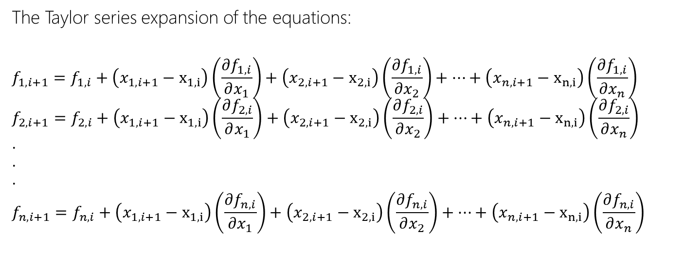
Newton-Raphson Method for solving system of nonlinear equations
The Taylor series expansion of the equations:
$$f_{1, i+1}=f_{1, i}+\left(x_{1,i+1}−x_{1,i}\right)\left(\frac{∂f_{1,i}}{∂x_{1}}\right)+\left(x_{2,i+1}−x_{2,i}\right)\left(\frac{∂f_{1,i}}{∂x_{2}}\right)+…+\left(x_{n,i+1}−x_{n,i}\right)\left(\frac{∂f_{1,i}}{∂x_{n}}\right)$$
$$f_{2, i+1}=f_{2, i}+\left(x_{1,i+1}−x_{1,i}\right)\left(\frac{∂f_{2,i}}{∂x_{1}}\right)+\left(x_{2,i+1}−x_{2,i}\right)\left(\frac{∂f_{2,i}}{∂x_{2}}\right)+…+\left(x_{n,i+1}−x_{n,i}\right)\left(\frac{∂f_{2,i}}{∂x_{n}}\right)$$
$$⋅$$
$$⋅$$
$$⋅$$
$$f_{n, i+1}=f_{n, i}+\left(x_{1,i+1}−x_{1,i}\right)\left(\frac{∂f_{n,i}}{∂x_{1}}\right)+\left(x_{2,i+1}−x_{2,i}\right)\left(\frac{∂f_{n,i}}{∂x_{2}}\right)+…+\left(x_{n,i+1}−x_{n,i}\right)\left(\frac{∂f_{n,i}}{∂x_{n}}\right)$$

Slide 7
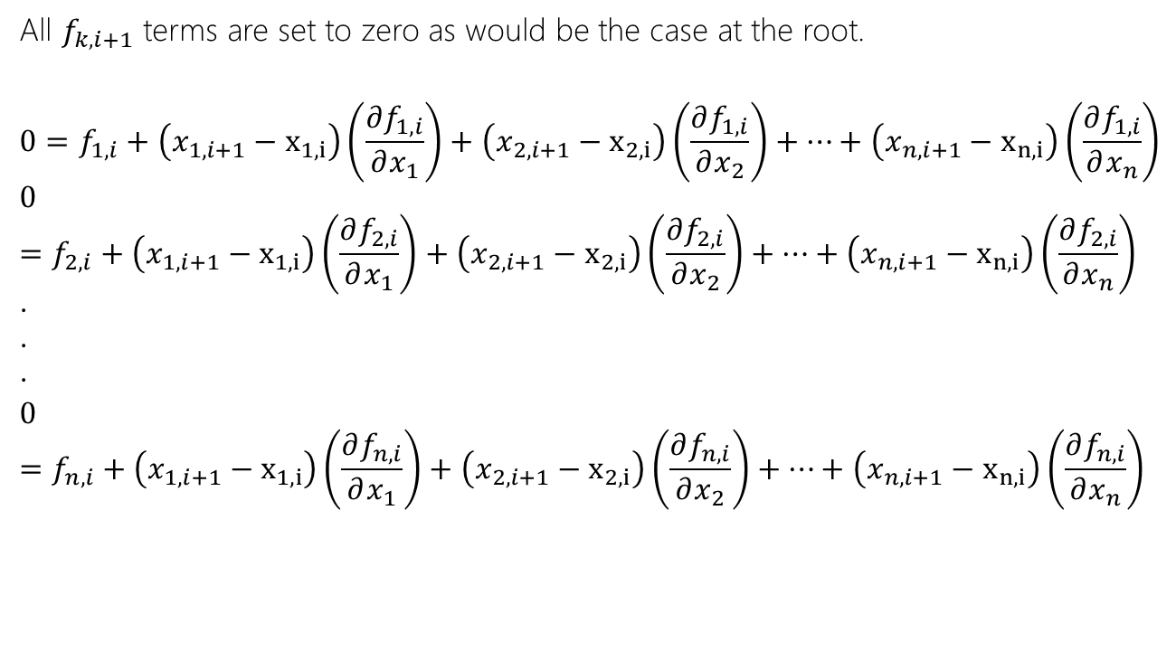
Newton-Raphson Method for solving system of nonlinear equations
All $f_{k,i+1}$ terms are set to zero as would be the case at the root.
$$0=f_{1, i}+\left(x_{1,i+1}−x_{1,i}\right)\left(\frac{∂f_{1,i}}{∂x_{1}}\right)+\left(x_{2,i+1}−x_{2,i}\right)\left(\frac{∂f_{1,i}}{∂x_{2}}\right)+…+\left(x_{n,i+1}−x_{n,i}\right)\left(\frac{∂f_{1,i}}{∂x_{n}}\right)$$
$$0=f_{2, i}+\left(x_{1,i+1}−x_{1,i}\right)\left(\frac{∂f_{2,i}}{∂x_{1}}\right)+\left(x_{2,i+1}−x_{2,i}\right)\left(\frac{∂f_{2,i}}{∂x_{2}}\right)+…+\left(x_{n,i+1}−x_{n,i}\right)\left(\frac{∂f_{2,i}}{∂x_{n}}\right)$$
$$⋅$$
$$⋅$$
$$⋅$$
$$0=f_{n, i}+\left(x_{1,i+1}−x_{1,i}\right)\left(\frac{∂f_{n,i}}{∂x_{1}}\right)+\left(x_{2,i+1}−x_{2,i}\right)\left(\frac{∂f_{n,i}}{∂x_{2}}\right)+…+\left(x_{n,i+1}−x_{n,i}\right)\left(\frac{∂f_{n,i}}{∂x_{n}}\right)$$

Slide 8

Newton-Raphson Method for solving system of nonlinear equations
The equations in a matrix form:
$$\left|\begin{matrix}\frac{∂f_{1,i}}{∂x_{1}} & \frac{∂f_{1,i}}{∂x_{2}} & … & \frac{∂f_{1,i}}{∂x_{n}} \\ \frac{∂f_{2,i}}{∂x_{1}} & \frac{∂f_{2,i}}{∂x_{2}} & … & \frac{∂f_{2,i}}{∂x_{n}} \\ ⋮ & ⋮ & ⋮ & ⋮ \\ \frac{∂f_{n,i}}{∂x_{1}} & \frac{∂f_{n,i}}{∂x_{2}} & … & \frac{∂f_{n,i}}{∂x_{n}}\end{matrix}\right|×\left|\begin{matrix}x_{1,i+1} \\ x_{2,i+1} \\ ⋮ \\ x_{n,i+1}\end{matrix}\right|=\left|\begin{matrix}{−f}_{1, i} \\ {−f}_{2, i} \\ ⋮ \\ {−f}_{n, i}\end{matrix}\right|+\left|\begin{matrix}\frac{∂f_{1,i}}{∂x_{1}} & \frac{∂f_{1,i}}{∂x_{2}} & … & \frac{∂f_{1,i}}{∂x_{n}} \\ \frac{∂f_{2,i}}{∂x_{1}} & \frac{∂f_{2,i}}{∂x_{2}} & … & \frac{∂f_{2,i}}{∂x_{n}} \\ ⋮ & ⋮ & ⋮ & ⋮ \\ \frac{∂f_{n,i}}{∂x_{1}} & \frac{∂f_{n,i}}{∂x_{2}} & … & \frac{∂f_{n,i}}{∂x_{n}}\end{matrix}\right|×\left|\begin{matrix}x_{1,i} \\ x_{2,i} \\ ⋮ \\ x_{n,i}\end{matrix}\right|$$
$$Z×X_{i+1}=−F_{i}+Z×X_{i}$$

Slide 9
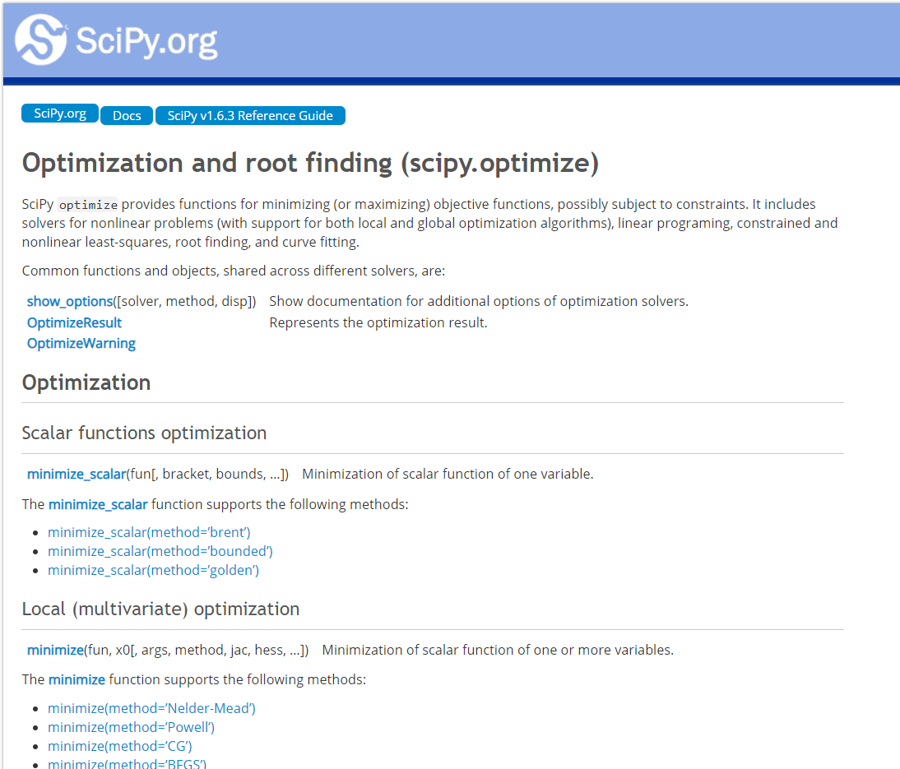
Introduction to Scipy.Optimize
We will use mainly:
newton
fsolve
https://docs.scipy.org/doc/scipy/reference/optimize.html

Slide 10
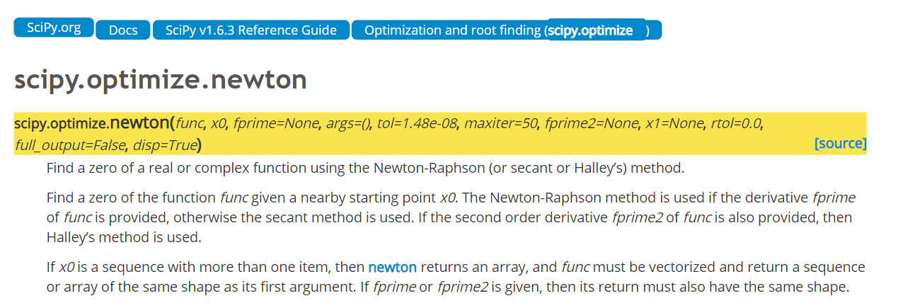
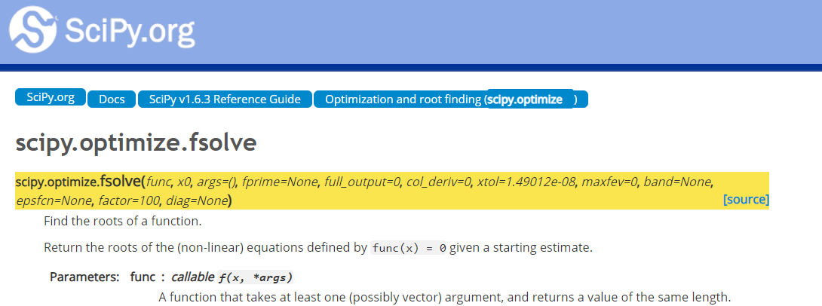
Introduction to Scipy.Optimize

Slide 11
Exercise Problem
2
Dp,Le
1
z2
z1
v,Q
Pump
This problem is adapted from the book of: Pemodelan Matematis dan Penyelesaian Numeris, Wahyudi B. Sediawan and Agus Prasetya, 1997 on page 115

Slide 12



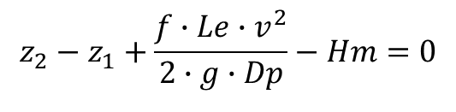
Exercise Problem
A liquid is transferred from tank 1 to tank 2 with pump via a pipe with diameter Dp. The equivalent length, Le, is provided. The characteristic of centrifugal pump which reflects the relationship between Q (cm3/s) and pump head (Hm, cm) can be approximated as:
By applying, Bernoulli equation between point 1 and 2, we obtain:
Friction factor is approximated by empirical relationship:
You are asked to estimate the liquid velocity (v) and flowrate (Q) in the pipe by using Secant method. Plot the value of v for various value of Dp (1<Dp<10 cm)
Calculation data: ρ=1 g/cm³, μ=0.01 g/(cm.s), g=981 cm/s², z₁=300 cm, z₂=800, Le=20000 cm.
$$Hm=3718.5−2.3496∙Q+7.8474∙{10}^{−4}∙Q^{2}−9.5812.{10}^{−8}∙Q^{3}$$
$$Q=\frac{π∙{Dp}^{2}∙v}{4}$$
$$z_{2}−z_{1}+\frac{f∙Le∙v^{2}}{2∙g∙Dp}−Hm=0$$
$$f=\frac{0.0596}{{Re}^{0.215}}$$
$$Re=\frac{ρ∙v∙Dp}{μ}$$

Slide 13
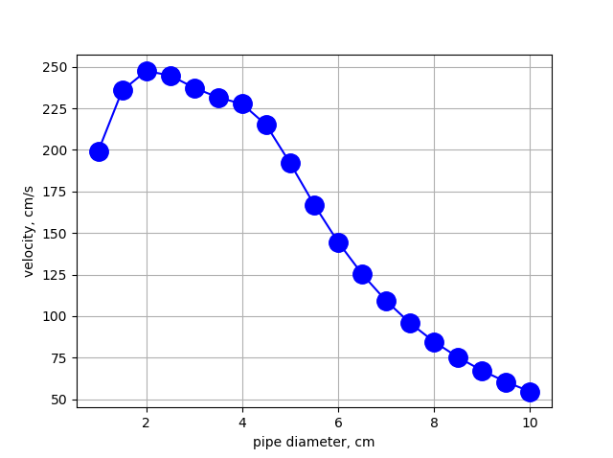



Program Structure
#Main program
#Data
…
#Calculation process
Prepare a vector of Dpspan
for loop to access each value of Dp
…
#Plotting and prepare table
v,Dp
v,Dp
Function to calculate F
Program
Secant
F is the output that should be zeroed
result
2
3
F
1
Secant result Dp [1]
Secant result Dp [2]
…
Secant result Dp [N]

